Slide 1
LUMINESCENCE

Slide 2
During fundamental absorption, an electron absorbs a photon from the incident beam and jumps from the valence band to the conduction band.
Thus, the electrons arc excited due to the absorption of energy.
The excited electrons can no longer be in the higher energy state and eventually decay back into a lower energy state by emitting radiation.
The process of emission of light by a material after absorbing energy other than heat energy, either in the form of light or electric field or high energy electrons, is known as luminescence.
Luminescence is the inverse process of absorption.

Slide 3
Principle
Let E₁ and E₂ be the energy of the lower and upper energy states, respectively.
When a light is incident on the material, due to the absorption of energy, the electrons are excited into a higher energy state E₂.
The excited electrons can no longer stay in the excited state E₂, and they eventually return back to the lower energy state E₁, by the emission of radiation of light of energy E given by,
E = hc/λ = E₂ – E₁
where, h is the Planck's constant and c the velocity of light.
The emitted wavelength (λ) is in band spectrum rather than a single spectrum, Due to the separate group of energy levels E₁ and E₂, the materials exhibit phosphorescence.
The emission of radiation of light (luminescence) from a solid material can be broadly classified based on the luminescence mechanism.

Slide 4
Photoluminescence :
The excitation arises due to the absorption of photon from the source such as infrared, visible, ultraviolet or X-rays.
Cathodoluminescence:
The excitation is due to the bombardment of high energy electron beam.
Electroluminescence:
The excitation is due to the application of either ac or dc electric current as in a p-n junction.
Injection luminescence:
Injection of minority carriers and subsequent radiative recombination with the majority carriers in a FB P-N Junction.

Slide 5
PHOTOLUMINESCENCE
Photoluminescence is usually divided into two different categories namely, fluorescence and phosphorescence.
If a substance absorbs light by any one of the above mechanisms, it radiates or emits light during excitation or within 10⁻⁸ s after the excitation is removed. This luminescence is known as fluorescence or fast photoluminescence.
This phenomena is temperature independent.
This property was first observed in fluorspar, i.e., calcium fluoride. Substances like fluorspar, fluorescein, quinine sulphate, uranium oxide, barium platinocyanide, calcite, uranium glass and some fossils exhibit the phenomena of fluorescence

Slide 6
On the other hand, certain substances emit light after the incident radiation is cut off.
This property is known as phosphorescence or slow photoluminescence.
The time delay between the electron excitation by the incident beam and the emission of light, ranges from 10⁻⁸s to several minutes or hours or even days.
For example, when Cds is illuminated by ultraviolet rays, it emits a pale blue light for about an hour.

Slide 7
The action of phosphorescence depends on the impurity ions known as activators present in the material.
The impurity ions or activators replace some of the host ions in the crystal lattice.
During this process, if the charge of the activators is not identical with that of the host ions, some of the activators will enter into the lattice due to the charge imbalance. As a result, some other impurity atoms with different ionic charges will be introduced, which are known as coactivators.
Luminescence materials are broadly classified into characteristic and non-characteristic materials, based on the existence of luminescence due to the different energy levels of activators and coactivators.
In characteristic luminescence, the excitation energy is transferred rapidly in a time less than 10⁻⁸ s to the activator ion.
On the other hand, in non characteristic luminescent materials, the excitation energy is transferred for a longer time than 10⁻⁸ s.

Slide 8
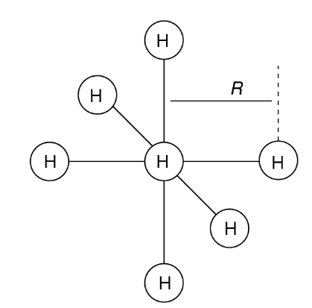
In characteristic luminescent materials, the activator ion absorbs energy directly from the incident photon.
Thus, the same energy levels are involved for both absorption and emission and hence, the wavelengths are identical.
The only difference between the two wavelengths is a shift in emission spectrum towards the red end of the absorption spectrum. This phenomenon is known as Stokes effect.
Let us consider that each charged activator (positively charged) ion is surrounded by six equidistant negatively charged ions (H) at a distance R from the activator.
Assumed impurity site structure in a characteristic luminescent material. The impurity ion (I) is surrounded by six host ions (H) each at a distance R from it.

Slide 9
When the activator is in its ground state, the most probable value of R is R_{O}, which corresponds to the minimum energy level.
The absorption of photon gives rise to a transition from A to B.
This transition takes place very rapidly since the ions in the luminescent centre could not have any time to rearrange.
The activator at B gives up heat energy to the surroundings by means of vibration and reaches the new position C (i.e., R = R1).
Then, the downward transition takes place from C to D, with the emitted photon having less energy than the absorbed photon. The observed band of absorption or emission of wavelength during the above process is due to the difference in the R-value from R₀ and R₁, respectively, during the absorption and emission processes.
The observed difference in R with the corresponding state is due to the oscillation state of the surrounding ions of the activators.

Slide 10
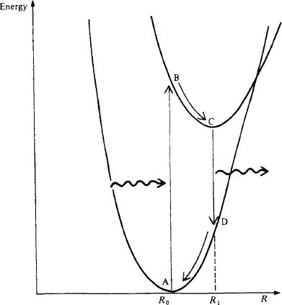
Variation in the energy of two electron energy levels of an impurity ion in a characteristic luminescent material as a function of the nearest neighbour ion separation R.
Stokes Shift E=hʋ
ʋ decreases, so λ incresaes.
ʋ increases, so λ decreases.
Red – Long Wavelength
Blue – Short Wavelength

Slide 11
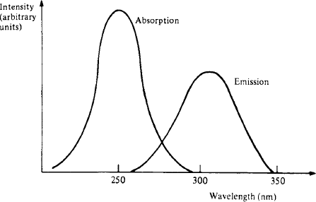
Absorption and emission spectra for thallium activated potassium chloride at room temperature
Emission peaks occurs at a higher wavelength than that of the absorption curve
The Stokes shift finds commercial applications in fluorescent lamps.

Slide 12
Phosphorescence:
In non characteristic luminescence materials, both activator and coactivator are normally present. The corresponding energy Ievels for the activators and coactivators are respectively known as hole and electron traps, which are similar to the acceptor and donor energy levels.
These energy levels lie in the energy gap in between the conduction and valence bands.
The electron-hole generation and recombination process in non-characteristic luminescent materials are shown in Fig.

Slide 13
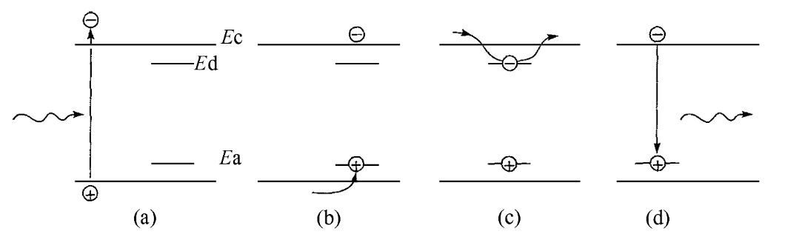
The absorption of energy by the solid, creates an electron-hole pair as shown in Fig.
Then, the holes are quickly trapped into the acceptor sites (b). The recombination of electrons with the trapped holes leads to luminescent emission (c).
It is also possible that the trapping of electrons occur at the donor site before recombination (c).
Figure (d) shows that the trapping of a hole by the acceptor level. The electrons may recombine with a trapped hole as shown in Fig (d) and hence, release a luminescent radiation.

Slide 14
The time taken by the electron in a trap depends on the depth of the trap below the conduction band (E_{c} - E_{d}) and the temperature T.
Therefore, the probability of energy = Q exp[-(Ec-Ed)/kT]
Where, Q is a constant and is equal to 10⁸ s⁻¹.
Problem:
The difference in energy level between the conduction and the valence band is 0.4 eV. Find the probability of escape per second of a trapped electron at room temperature. Given that kT = 0.025 eV.
Energy difference E_{c} - E_{d} = 0.4 eV
The value of kT= 0.025 ev
The escape rate per unit time = Q exp -[(E_{c} - Ed)/kT]
11.2 s⁻¹
Therefore, the luminescent lifetime is nearly 11s.

Slide 15
Thus, it is clear from the above discussion that the impurity levels introduced by the activators inside the band gap plays a vital role in determining the emission of light. In this material, the emission of light occurs rather slowly due to the electron-hole recombination which takes place indirectly through the impurity levels.
Therefore, this process is known as phosphorescence or slow photoluminescence.
The non characteristic luminescent materials are used in display applications due to their slow photoluminescence property
PHOSPHORS
The materials which are used to produce luminescence are known as phosphors.
Generally, phosphors absorb the light waves with low wavelengths and spontaneously emit light waves with high wavelengths.
For example, the sulphides of calcium, barium, strontium, zinc, etc., with certain added impurities known as activators, emit lights ranging from several minutes to hours or even days.
These materials are known as complex phosphors. Complex phosphorous materials exhibit strong phosphorescence and hence, they are used in display applications.

Slide 16
CATHODOLUMINESCENCE
In case of Cathodoluminescence, the emission process is same as that of photoluminescence. however, they are different in the actual excitation mechanism.
In Cathodoluminescence, when a beam of electrons of energy, greater than 1 keV, strike a solid material, about 10% of the incident electrons will be backscattered.
The remaining 90% of the electrons will penetrate into the solid and hence, dislodge the bound electrons from their parent ions. These electrons in turn further generate secondary electrons.
At the final stage, these electrons are excited from the top of the valence band (E_{c}) to the bottom of the conduction band (E_{v}) by creating an electron - hole pair with minimum energy of the exciting electrons as E_{g} = (E_{c}-E_{v}).

Slide 17
During this process. some of the energy, in the form of photon (heat) and lattice vibrations, is wasted.
Therefore, the minimum energy required for the above process is E_{c} + 3E_{g}/2.
In view of the rapid loss of energy of the primary electrons, the penetration depth or range is less and is given by R_{c} = KE_{B}^{b}
where, EB is the energy of the incident beam, and K and b are the constants depending on the material.
It is interesting to note that the efficiency of Cathodoluminescence increases with increase in beam voltage.
The important requirement of Cathodoluminescence is luminescent phosphor, due to its high secondary emission properties. The major application of Cathodoluminescence is in cathode ray oscilloscopes and television picture tubes.

Slide 18
Determine the penetration depth of the primary electrons in ZnS for an Incident beam
energy of 10 keV. Given that K =1.2 x 10⁻⁴ and b=0.151.
Solution :
The energy of the incident beam EB=10 keV
K = 1.2 x 10-4
b = 0.151
The penetration depth of the electron
R_{c}=KE_{B}^{b}
0.6998 µm.
The penetration depth of the electron is 0.6998 µm.

Slide 19
ELECTROLUMINESCENCE:
The phosphor particles namely ZnS:Cu are suspended in a nonconducting transparent insulating binding medium of high dielectric constant, as shown in Fig.
This medium is sandwiched in between two electrodes namely, highly transparent (SnO₂) and a metal electrode.
As a result, there is no complete conduction path between the two electrodes and hence, the excitation cannot take place.
When an ac voltage is applied between the electrodes, a short burst of light is emitted for every half cycle for a period of 10⁻³ s.
Due to the application of ac voltage, a high electric field is known to exist within the phosphor particle.

Slide 20
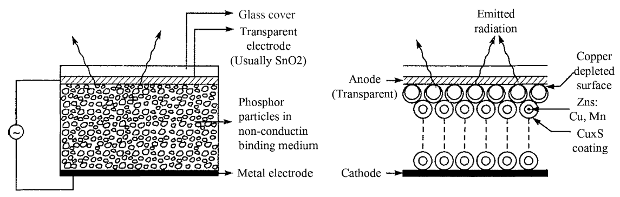
CONSTRUCTION OF AN AC ELECTROLUMINESCENT DEVICE
When an alternating voltage is applied to the electrodes the phosphor particles emit light.
Vo Cos(2πft)
Phosphor particles are suspended within a transparent insulating medium and sandwiched between two electrodes, one of which is transparent.
Under normal conditions, light is emitted only from the CUxS depleted particles.

Slide 21

The construction of a d.c. electroluminescent device.
The phospor particles have a coating of CUxS.
This coating is removed from the anode side of the particles in contact with the anode by the application of an initial high current pulse.
Under normal conditions, light is emitted only from the CUxS depleted particles.
The integrated light output power P is
Where V1 is constant, Po(f) is a function of frequency

Slide 22
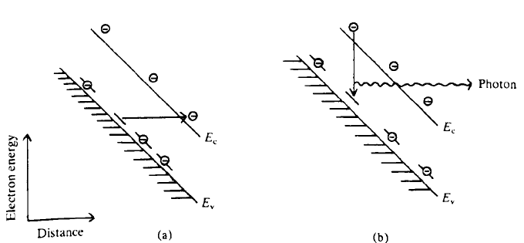
EMISSION INVOLVING QUANTUM MECHANICAL TUNNELLING
(A) An electron in an acceptor state “tunnels” through the forbidden gap region into states of the same energy.
It is only able to do this if there is a considerable electric field present, thus cause the energy bands to be tilted.
(B) An electron in the conduction band may now fall into the vacated level resulting in radiative emission.

Slide 23
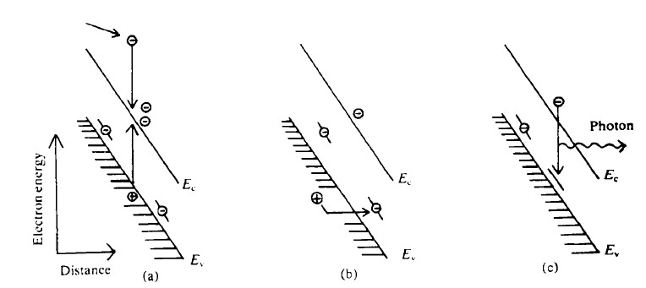
EMISSION INVOLVING AN AVALANCHE PROCESS
(A) An electron moving in the high electric fields present may acquire sufficient energy to excite an electron from the valence band into the conduction band.
(B) The hole left behind then moves up into an acceptor state effectively emptying it of an electron.
(C) An electron in the conduction band may then make a radiative transfer into the empty acceptor level.

Slide 24
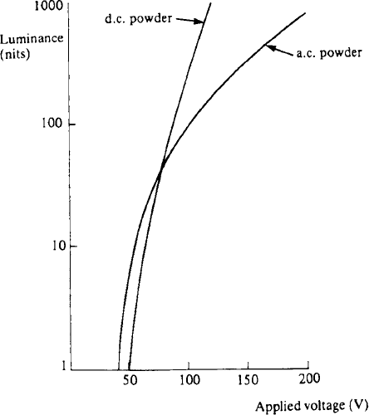
TYPICAL LUMINANCES FOR AC & DC EL POWER DEVICES

Slide 25
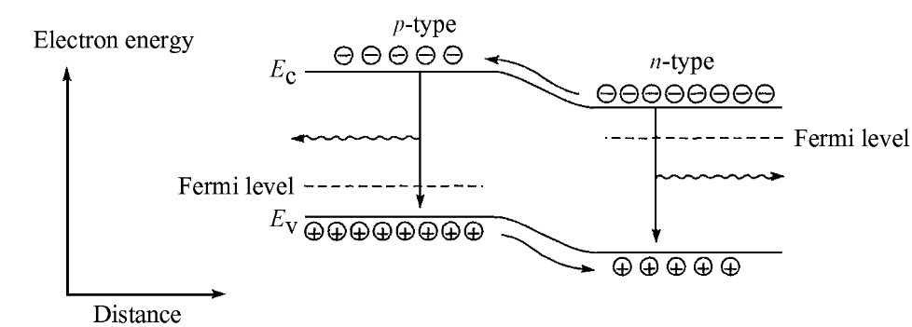
INJECTION OF MINORITY CARRIERS AND SUBSEQUENT RADIATIVE RECOMBINATION WITH THE MAJORITY CARRIERS IN A FB P-N JUNCTION
INJECTION LUMINESCENCE

Slide 26
Under FB, majority carriers from both sides of the junction cross the internal potential barrier and enter the material at the other side.
Now they causes the local minority carrier population to be larger than normal - Minority Carrier Injection.
Recombines with majority carriers- Radiative recombination

Slide 27
The current (I) and voltage (V) relationship for a diode can be written as
I=I₀[exp(eV/βkt)-1]
where, I0 is the saturation current and βvaries between 1 and 2, depending on the semiconductor and temperature.
This type of recombination in semiconductors occur in three different ways namely, internal transition, recombination via. impurity centres and exciton recombination.
The injection electroluminescence has been observed in a number of semiconductors such as silicon (Si), germanium (Ge), cadmium sulphide (CdS), zinc sulphide (ZnS), zinc selenide (ZnSe), zinc telluride (ZnTe), zinc oxide (ZnO), gallium phosphide (GaP), gallium arsenide (GaAs), boron nitride (BN), etc.

Slide 28
APPLICATIONS
Following are some of the applications of fluorescent materials:
Fluorescent materials are used in display devices such as CRT, LED, LCD, etc.
b. A fluorescent lamp consists of a thin coating of a material like magnesium tungstate, zinc silicate, cadmium borate or zinc beryllium silicate. When ultraviolet radiations are made to fall on such type of materials, they absorb the incident radiation and re-emit the light having the wavelength in the visible region, and hence, increases the luminous flux.
c. When X-rays are made to fall on a glass coated with barium platinocyanide, it produces a fluorescent light Therefore, it is used as a detector for X-rays.
d, The yellow-brown tint of a washed fabric is removed by adding certain fluorescent chemicals with the washing powder. These fluorescent chemicals arc used to increase the whiteness of the fabric.
e. Fluorescent paints are prepared by adding some fluorescent chemicals to the paints. When they are illuminated by light during the night time, they become visible.
f. Watch dials and clocks are coated with certain fluorescent chemicals like radium compounds.

Slide 29
• Luminescence is the process of emission of light by a material after absorbing energy other than heat energy, either in the form of light or electric field or high energy electrons,
• The energy of emitted radiation is equal to E= hc/λ where, h is the Planck's constant, c the velocity of light and k the wavelength of light.
• In photoluminescence, the excitation arises due to the absorption of photons from the source such as infrared, visible or X-rays.
• In Cathodoluminescence, the excitation is due to the bombardment of high energy electron field.

Slide 30
• Electroluminescence process takes place due to excitation of either ac or dc electric field.
• Fluorescence is the process of emission of light during excitation or with 10⁻⁸ after the excitation is removed.
• Complex phosphors are the materials which emit light ranging from several minutes to hours or even some days to certain added impurities known as activators.
• When a semiconductor p-n junction or point contact is forward biased, the radiated emission is known as injection electroluminescence.

Slide 31
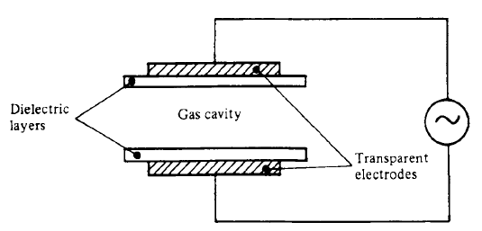
CONSTRUCTION OF A.C. PLASMA ELEMENT
Principle: Glow is produced when an electric current is passed through a gas ( neon)
Electrodes are placed external to the gas cavity.
Gas cavity is 10⁻⁴ m in width with transparent electrodes on the outside of the containing dielectric layers.
Gas gets ionized.
Free electrons increases their kinetic energy and collide with atoms exciting them.
During recombination- Photons

Slide 32
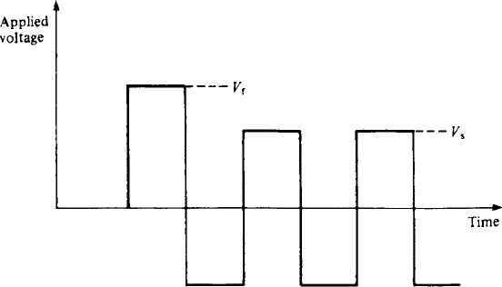
VOLTAGE WAVEFORM USED FOR DRIVING AN A.C. DISPLAY
Initial firing pulse is V_{f} (150 V) and it is reduced to V_{s} (90 V) for the remaining time.

Slide 33
LIQUID CRYSTAL DISPLAYS
PASSIVE DISPLAY
They consume less power because no light generation is required.

Slide 34
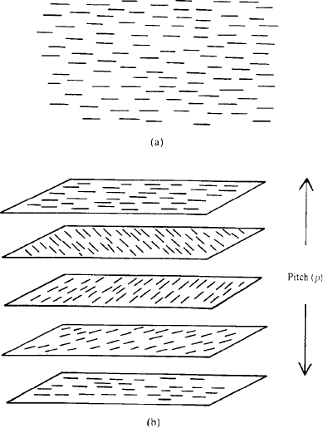
(A) NEMATIC ORDERING (B) CHOLESTERIC ORDERING
(A) The directors all line up parallel to each other.
(B) A large number of planes of nematic order are formed where the directors rotate as we move along a direction perpendicular to the planes

Slide 35
BEHAVIOUR OF MOLECULES IN AN HOMOGENEOUSLY ORDERED LIQUID CRYSTAL MATERIAL
Electric field of magnitude ε is applied in a direction perpendicular to the liquid crystal / solid interface.
If ε is less than a critical value ε_{c} the ordering is not affected.
ε > ε_{c} the molecules furthest away from the interface begin to align along the field direction
ε > > ε_{c} then most of molecules are aligned along the field direction.

Slide 36
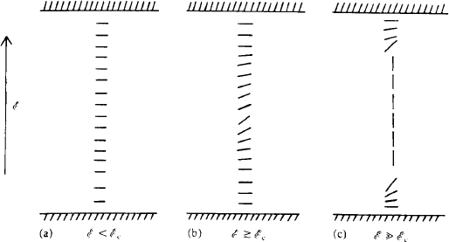

Slide 37
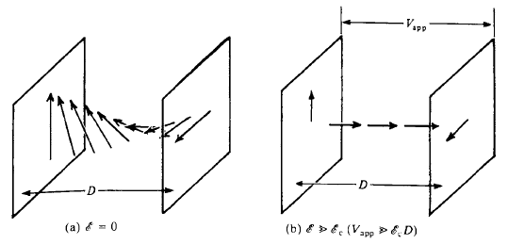
BEHAVIOUR OF THE MOLECULES IN A LIQUID CRYSTAL CELL OF THICKNESS D
No applied Voltage- the molecules undergo a 90 degree rotation across the cell.
ε > εc - the molecules are mostly ordered with their axes parallel to the applied field.

Slide 38
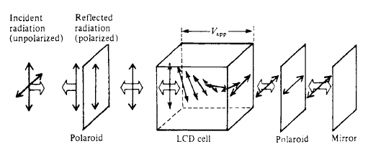
ACTION OF AN LCD DISPLAY DEVICE
Behaviour of a polarized beam as it traverses the system.
When no applied voltage, the incident light is first polarized, then has its polarization direction rotated by 90 degree as it traverses the cell, then passes through the second polarizer and is then reflected back along its path where the same process is repeated.
Thus, the devices reflects incident radiation and appears bright under zero applied field.

Slide 39
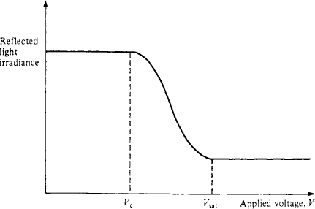
LCD GRAPH
Amount of light reflected from a LCD as a function of applied voltage V.
The reflected irradiance remains constant up-to the critical voltage V_{c}, it then falls with increasing voltage until it again becomes constant beyond V_{sat}.

Slide 40
NUMERIC DISPLAYS

Slide 41
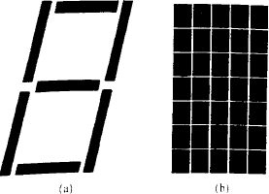
TWO COMMON DISPLAY FORMATS
Seven bar segment display used to form the numbers from 0 to 9.
Each bar might itself consist of several discrete display elements depending on its size.
7 * 5 matrix display – more complex characters

Slide 42
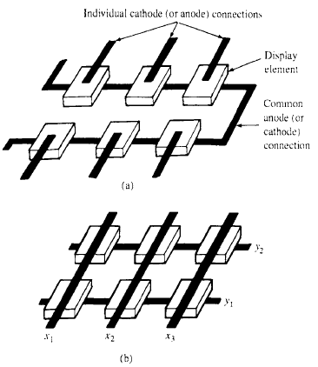
METHODS OF WIRING UP A MATRIX DISPLAY
Common anode- Anodes are all wired together while each cathode has a separate connection made to it.
For N elements the number of
external connections is N+1.
Coordinate connected – Matrix connected- requires fewer connections.
All the anodes of the elements in each column are connected together as all the cathodes of the elements are connected.

Slide 43
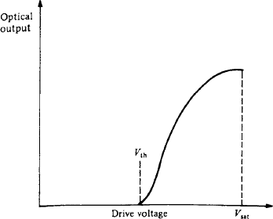
IDEAL CHARACTERISTIC FOR A DEVICE SUITABLE FOR MATRIX ADDRESSED DISPLAYS
The device shows no optical output up to a threshold drive voltage V_{th}.
Then the output increases to a maximum at a drive voltage of V_{sat}.

Slide 44
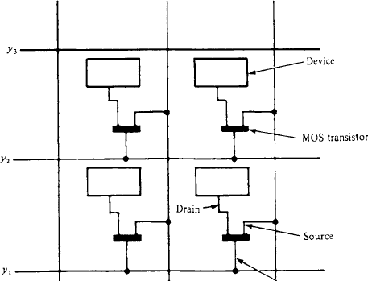
METHOD USED FOR LCD MATRIX OPERATION USING AN MOS TRANSISTOR
The element may be held on during the time between addressing by virtue of the charge held on the drain terminal.
To address an element the gate of the attached MOST is opened by applying potential to the appropriate y line.
The voltage that is on the corresponding x line then appears across the device.

